Slide 1


CLOUD COMPUTING AND SECURITY
MODULE-2
By. Mr. Mohammad Tahir Mirji Dep. of AI & ML
Dept. of AI & ML

Slide 2
Virtual Machines and Virtualization of Clusters and datacenters
Dept. of AI & ML

Slide 3
Virtualization for Datacenter Automation to serve millions of clients, simultaneously
Server Consolidation in Virtualized Datacenter
Virtual Storage Provisioning and Deprovisioning
Cloud Operating Systems for Virtual Datacenters
Trust Management in virtualized Datacenters
Dept. of AI & ML

Slide 4
Difference between Traditional Computer and Virtual machines
Dept. of AI & ML

Slide 5
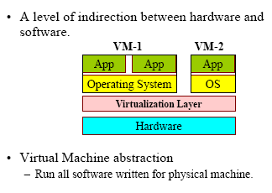
What is Virtualization ?
Dept. of AI & ML

Slide 6
Dept. of AI & ML

Slide 7
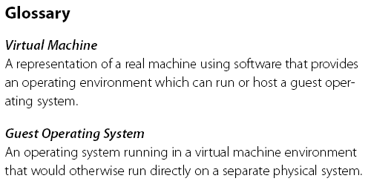
Virtual Machine, Guest Operating System, and VMM (Virtual Machine Monitor) :
Dept. of AI & ML
The Virtualization layer is the middleware between the underlying hardware and virtual machines represented in the system, also known as virtual machine monitor (VMM).

Slide 8
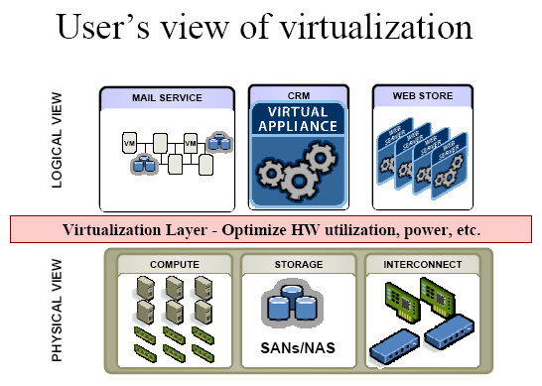
Dept. of AI & ML

Slide 9
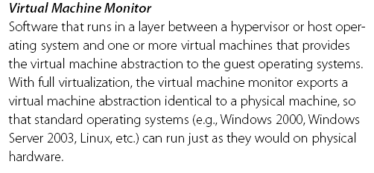
VMM : Virtual Machine Monitor
Dept. of AI & ML

Slide 10
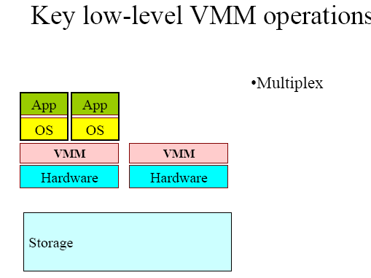
Low-Level VMM Operations (1)
Dept. of AI & ML

Slide 11
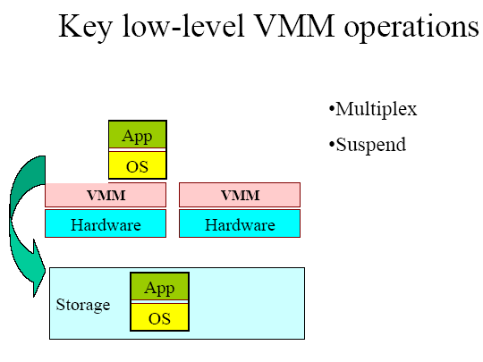
Low-Level VMM Operations (2)
Dept. of AI & ML

Slide 12
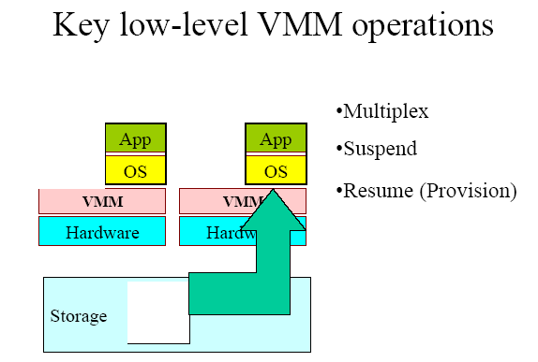
Low-Level VMM Operations (3)
Dept. of AI & ML

Slide 13
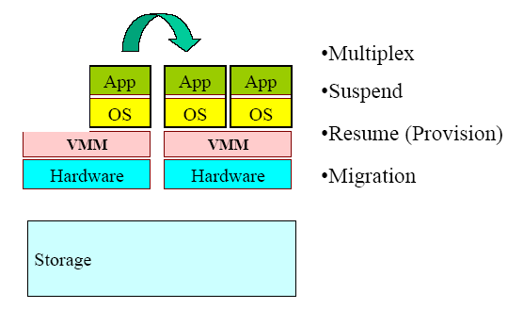
Low-Level VMM Operations (4)
Dept. of AI & ML

Slide 14
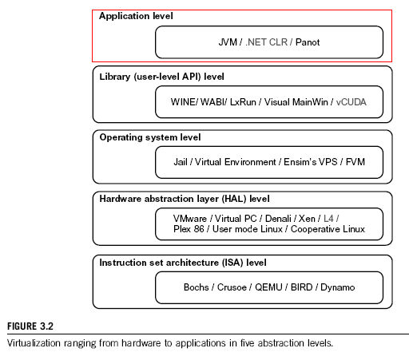
Dept. of AI & ML

Slide 15
Virtualization at ISA level:
Emulating a given ISA by the ISA of the host machine. For example, MIPS binary code can run on an x-86-based host machine with the help of ISA emulation. Typical systems: Bochs, Crusoe, Quemu, BIRD, Dynamo
Advantage: It can run a large amount of legacy binary codes written for various processors on any given new hardware host machines; best application flexibility
Shortcoming & limitation: One source instruction may require tens or hundreds of native target instructions to perform its function, which is relatively slow. V-ISA requires adding a processor-specific software translation layer in the complier.
Dept. of AI & ML

Slide 16
Virtualization at Hardware Abstraction level: Virtualization is performed right on top of the hardware. It generates virtual hardware environments for VMs, and manages the underlying hardware through virtualization. Typical systems: VMware, Virtual PC, Denali, Xen
Advantage: has higher performance and good application isolation
Shortcoming & limitation: very expensive to implement (complexity)
Dept. of AI & ML

Slide 17
Virtualization at Operating System level:
It is an abstraction layer between traditional OS and user placations. This virtualization creates isolated containers on a single physical server and the OS-instance to utilize the hardware and software in datacenters. Typical systems: Jail / Virtual Environment / Ensim's VPS / FVM
Advantage: have minimal starup/shutdown cost, low resource requirement, and high scalability; synchronize VM and host state changes.
Shortcoming & limitation: all VMs at the operating system level must have the same kind of guest OS; poor application flexibility and isolation.
Dept. of AI & ML

Slide 18
Virtualization at OS Level
Dept. of AI & ML

Slide 19
Virtualization for Linux and Windows NT Platforms
Dept. of AI & ML

Slide 20
Advantages of OS Extension for Virtualization
VMs at OS level has minimum startup/ shutdown costs
OS-level VM can easily synchronize with its environment
Disadvantage of OS Extension for Virtualization All VMs in the same OS container must have the same or similar guest OS, which restrict application flexibility of different VMs on the same physical machine.
Dept. of AI & ML

Slide 21
Library Support level:
It creates execution environments for running alien programs on a platform rather than creating VM to run the entire operating system. It is done by API call interception and remapping.
Typical systems: Wine, WAB, LxRun , VisualMainWin
Advantage: It has very low implementation effort
Shortcoming & limitation: poor application flexibility and isolation
Dept. of AI & ML

Slide 22
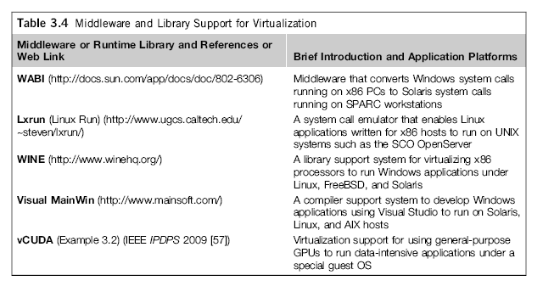
Virtualization with Middleware/Library Support
Dept. of AI & ML

Slide 23
User-Application level:
It virtualizes an application as a virtual machine. This layer sits as an application program on top of an operating system and exports an abstraction of a VM that can run programs written and compiled to a particular abstract machine definition.
Typical systems: JVM , NET CLI , Panot
Advantage: has the best application isolation
Shortcoming & limitation: low performance, low application flexibility and high implementation complexity.
Dept. of AI & ML

Slide 24
Dept. of AI & ML

Slide 25
Full Virtualization vs. Para-Virtualization
Full virtualization does not need to modify guest OS, and critical instructions are emulated by software through the use of binary translation. On the other hand, para virtualization needs to modify guest OS, and non-virtualizable instructions are replaced by hypercalls that communicate directly with the hypervisor or VMM. As of full virtualization, the advantage is no need to modify OS. However, this approach of binary translation slows down the performance a lot.
Para virtualization reduces the overhead, but the cost of maintaining paravirtualized OS is high. The improvement depends on the workload. VMware Workstation applies full virtualization, which uses binary translation to automatically modify x86 software on-the-fly to replace critical instructions. The para virtualization is supported by Xen, Denali and VMware ESX.
Dept. of AI & ML

Slide 26
Full Virtualization
Dept. of AI & ML

Slide 27

Dept. of AI & ML

Slide 28
Feather- Weight VM (FVM)
Dept. of AI & ML

Slide 29
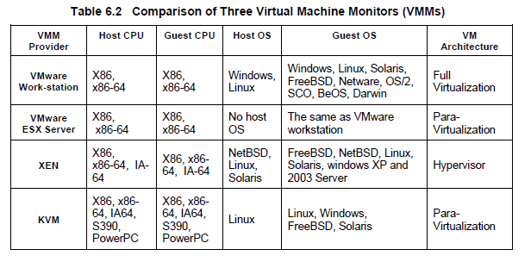
Major VMM and Hypervisor Providers
Dept. of AI & ML

Slide 30
The vCUBE for Virtualization of GPGPU
Dept. of AI & ML

Slide 31
Hypervisor
A hypervisor is a hardware virtualization technique allowing multiple operating systems, called guests to run on a host machine. This is also called the Virtual Machine Monitor (VMM).
Type 1 hypervisor or the bare metal hypervisor sits on the bare metal computer hardware like the CPU, memory, etc. All the guest operating systems are a layer above the hypervisor. So the hypervisor is the first layer over the hardware. The original CP/CMS hypervisor developed by IBM was of this kind. Examples are Microsoft Hyper-V.
Type 2 or the hosted hypervisor do not run over the bare metal hardware but they run over a host operating system. The hypervisor is the second layer over the hardware. The guest operating systems run a layer over the hypervisor and so they form the third layer. Examples are FreeBSD. The operating system is usually unaware of the virtualization
Dept. of AI & ML

Slide 32
Hypervisor and the XEN Architecture
Dept. of AI & ML

Slide 33
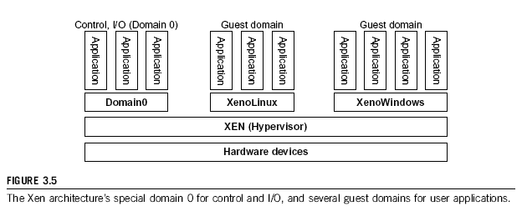
The XEN Architecture (1)
Dept. of AI & ML

Slide 34
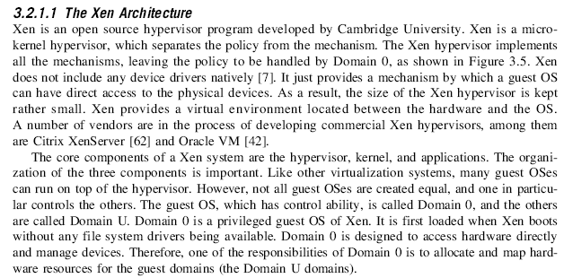
The XEN Architecture (2)
Dept. of AI & ML

Slide 35
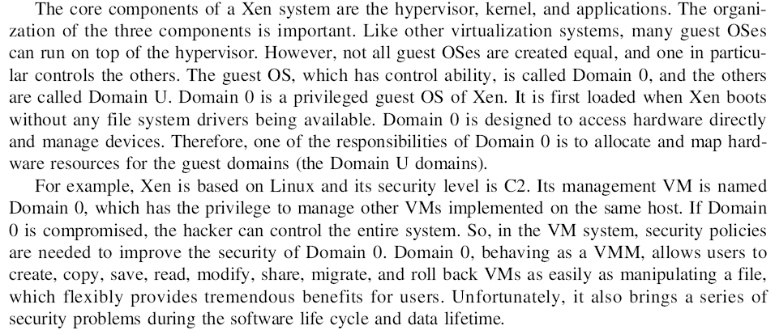
The XEN Architecture (3)
Dept. of AI & ML

Slide 36
Para-Virtualization
In para-virtualization, the guest operating system has to be modified. Para-virtualization provides specially defined ‘hooks’ to do some tasks in the host and guest operating systems, which would otherwise have been done in a virtual environment, which is slower.
The VMM in a para-virtualized platform is simpler because the critical tasks are now performed in the operating system rater than by the VMM. Since the virtualization overhead decreases the performance increases.
Some of the disadvantages are the compatibility and the portability is reduces because of the modified operating system. Also the cost of maintenance is high because of the deep OS modifications.
Some examples of Para-virtualization are KVM and the XenWindowsGplPv project.
Dept. of AI & ML

Slide 37
Para- Virtualization with Compiler Support.
The KVM builds offers kernel-based VM on the Linux platform, based on para-virtualization
Dept. of AI & ML

Slide 38
Host-based Virtualization
Dept. of AI & ML

Slide 39
Virtual Cores vs. Physical Processor Cores
Physical cores | Virtual cores
The actual physical cores present in the processor. | There can be more virtual cores visible to a single OS than there are physical cores.
More burden on the software to write applications which can run directly on the cores. | Design of software becomes easier as the hardware assists the software in dynamic resource utilization.
Hardware provides no assistance to the software and is hence simpler. | Hardware provides assistance to the software and is hence more complex.
Poor resource management. | Better resource management.
The lowest level of system software has to be modified. | The lowest level of system software need not be modified.
Dept. of AI & ML

Slide 40
Binary Translation of Guest OS Requests using a VMM:
Dept. of AI & ML

Slide 41
Dept. of AI & ML

Slide 42
Hypercall Execution
Dept. of AI & ML

Slide 43
VMWare ESX Server for Para-Virtualization
Dept. of AI & ML

Slide 44
Virtualization Support at Intel
Dept. of AI & ML

Slide 45
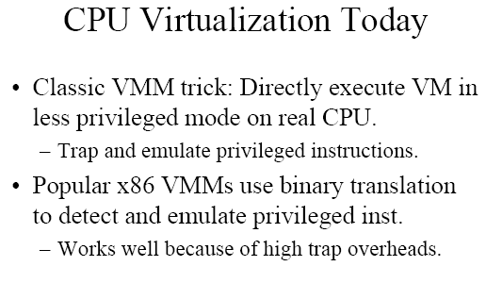
Dept. of AI & ML

Slide 46
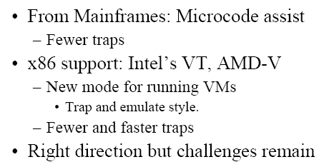
Dept. of AI & ML

Slide 47
Dept. of AI & ML

Slide 48
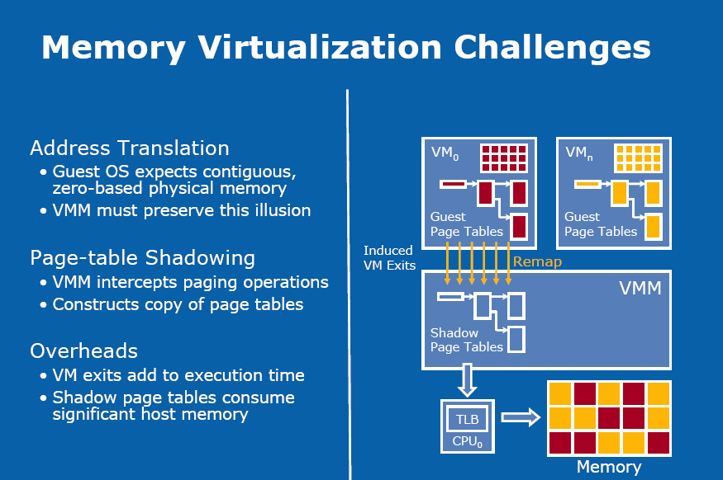
Dept. of AI & ML

Slide 49
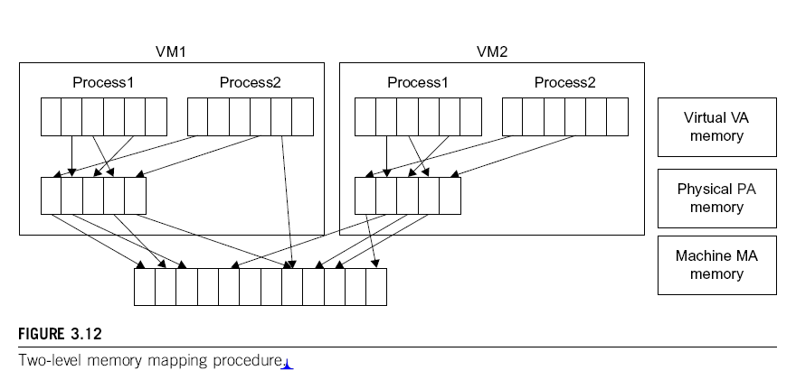
Dept. of AI & ML

Slide 50
Dept. of AI & ML

Slide 51
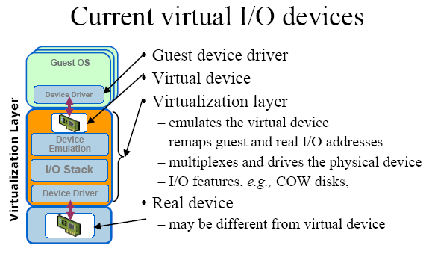
Dept. of AI & ML

Slide 52
Dept. of AI & ML

Slide 53
Conclusions on CPU, Memory and I/O Virtualization :
CPU virtualization demands hardware-assisted traps of sensitive instructions by the VMM
Memory virtualization demands special hardware support (shadow page tables by VMWare or extended page table by Intel) to help translate virtual address into physical address and machine memory in two stages.
I/O virtualization is the most difficult one to realize due to the complexity if I/O service routines and the emulation needed between the guest OS and host OS.
Dept. of AI & ML

Slide 54
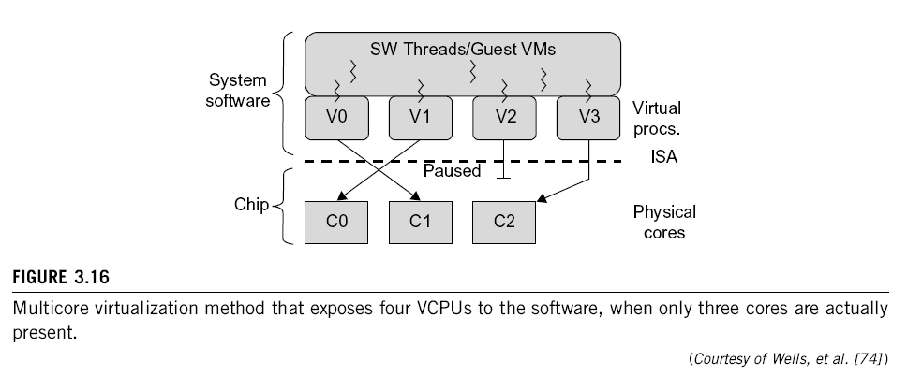
Multi-Core Virtualization: VCPU vs. traditional CPU
Dept. of AI & ML
Figure 3.16 Four VCPUs are exposed the software, only three cores are actually present. VCPUs V0, V1, and V3 have been transparently migrated, while VCPU V2 has been transparently suspended. (Courtesy of Wells, et al., “Dynamic Heterogeneity and the Need for Multicore Virtualization”, ACM SIGOPS Operating Systems Review, ACM Press, 2009 [68] )

Slide 55
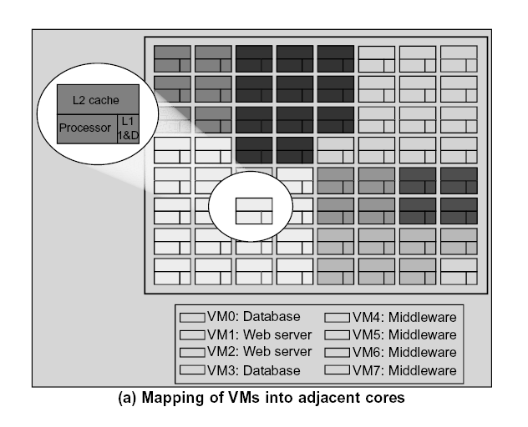
Dept. of AI & ML

Slide 56
Virtual Clusters in Many Cores Space Sharing of VMs -- Virtual Hierarchy
Dept. of AI & ML

Slide 57
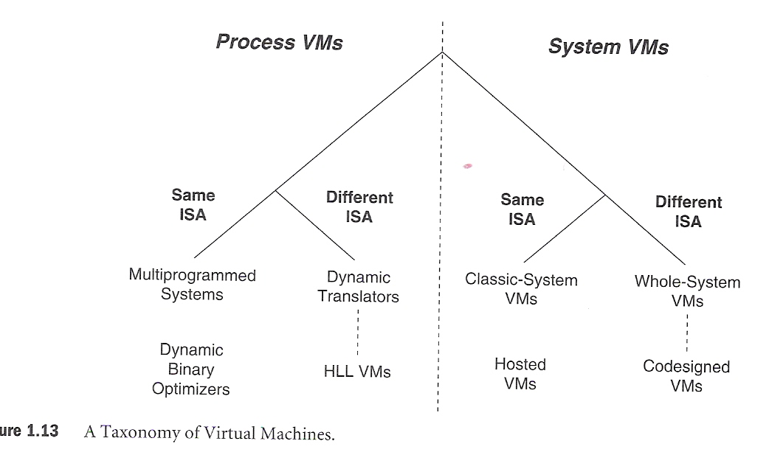
A Taxonomy of Virtual Machines
Dept. of AI & ML

Slide 58
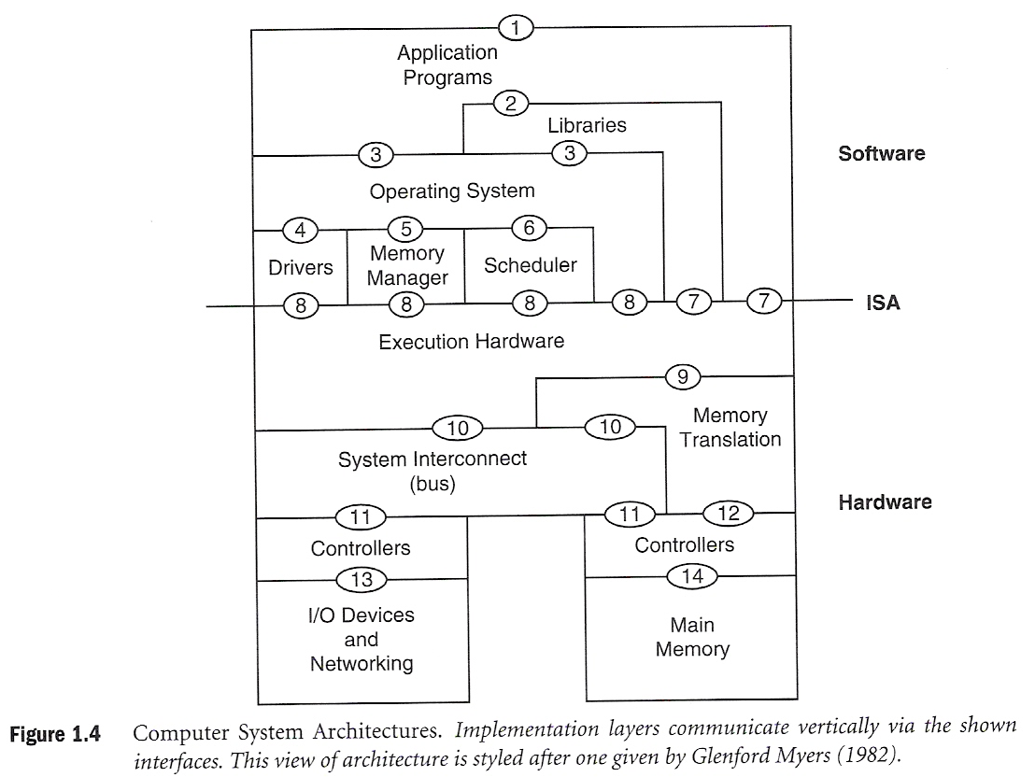
Dept. of AI & ML

Slide 59
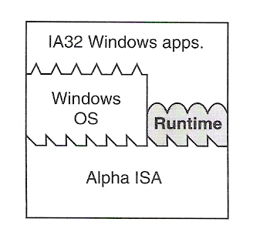
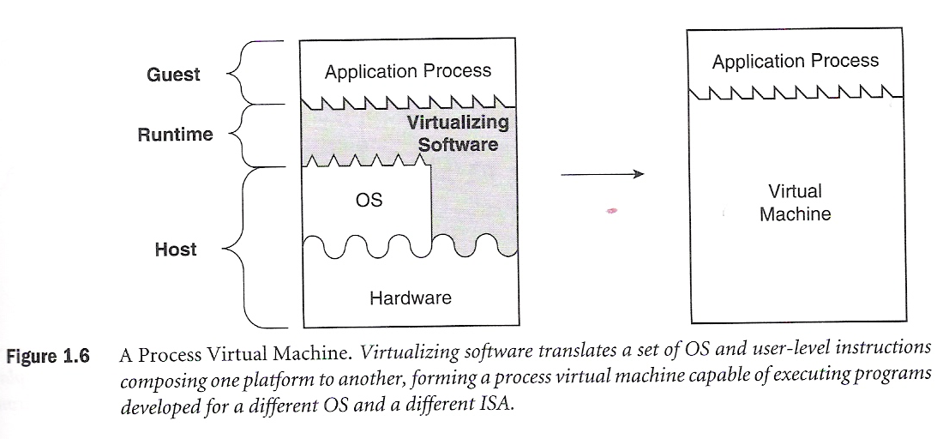
Dept. of AI & ML
Process VM : An example that emulates Guest IA32 Applications to run on an Alpha Windows platform

Slide 60
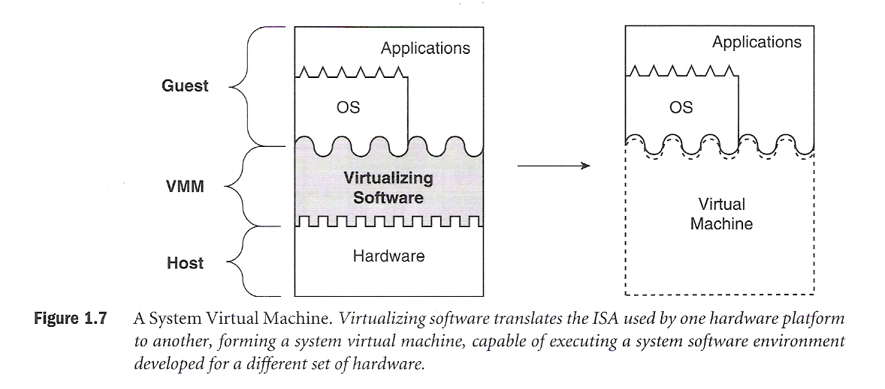
System Virtual Machine
Dept. of AI & ML

Slide 61
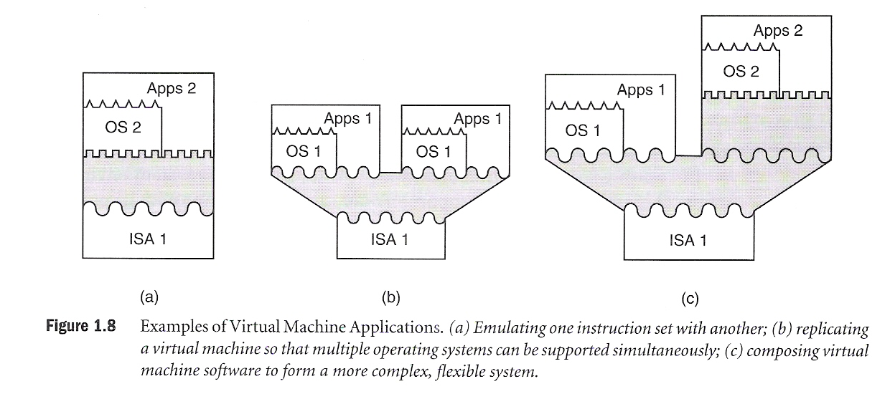
Example of Virtual Machine Applications
Dept. of AI & ML

Slide 62
Virtual Cluster Characteristics
The virtual cluster nodes can be either physical or virtual machines. Multiple VMs running with different OSs can be deployed on the same physical node.
A VM runs with a guest OS, which is often different from the host OS, that manages the resources in the physical machine, where the VM is implemented.
The purpose of using VMs is to consolidate multiple functionalities on the same server. This will greatly enhance the server utilization and application flexibility.
VMs can be colonized (replicated) in multiple servers for the purpose of promoting distributed parallelism, fault tolerance, and disaster recovery.
The size (number of nodes) of a virtual cluster can grow or shrink dynamically, similarly to the way an overlay network varies in size in a P2P network.
The failure of any physical nodes may disable some VMs installed on the failing nodes. But the failure of VMs will not pull down the host system.
Dept. of AI & ML

Slide 63
Virtual Clusters vs. Physical Clusters
Dept. of AI & ML

Slide 64
Dept. of AI & ML

Slide 65
Virtual Cluster Projects
Dept. of AI & ML

Slide 66
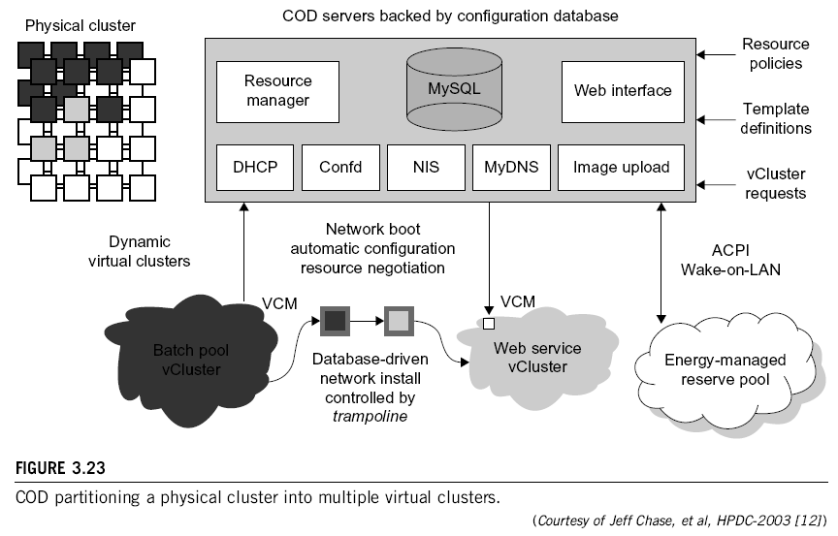
Dept. of AI & ML

Slide 67
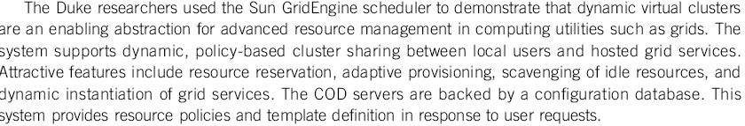
Cluster-on-Demand (COD Project at Duke University
Dept. of AI & ML

Slide 68
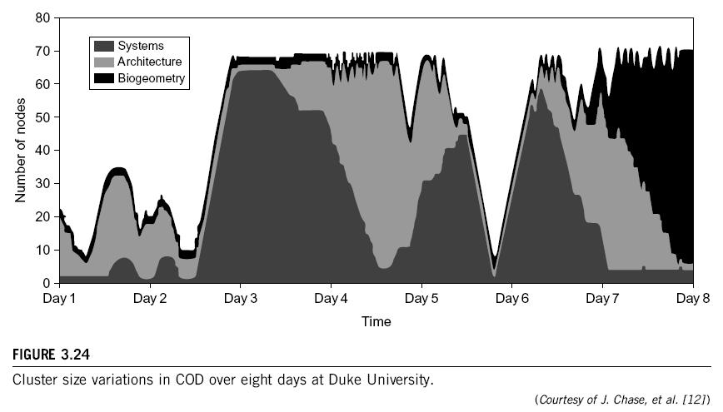
Dept. of AI & ML

Slide 69
VIOLIN Project at Purdue University
Dept. of AI & ML

Slide 70
Dept. of AI & ML

Slide 71
Live Migration of Virtual Machines
Dept. of AI & ML

Slide 72
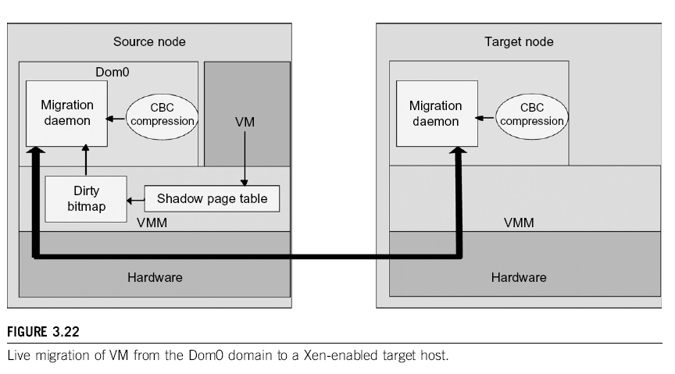
Dept. of AI & ML

Slide 73
Dept. of AI & ML

Slide 74
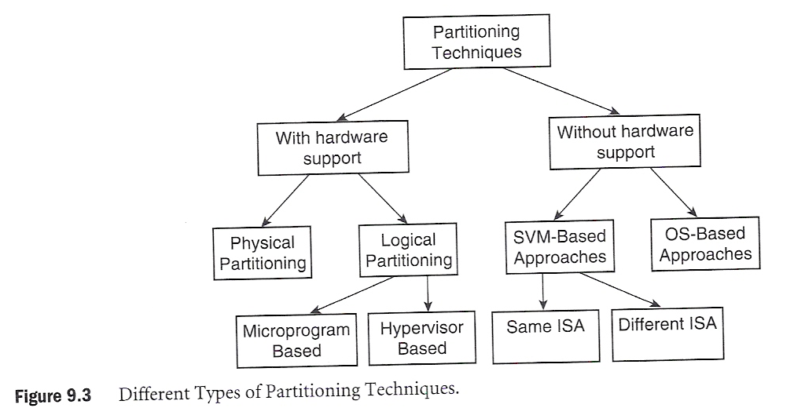
Cluster Partitioning for VM-based Parallel Systems
Dept. of AI & ML

Slide 75
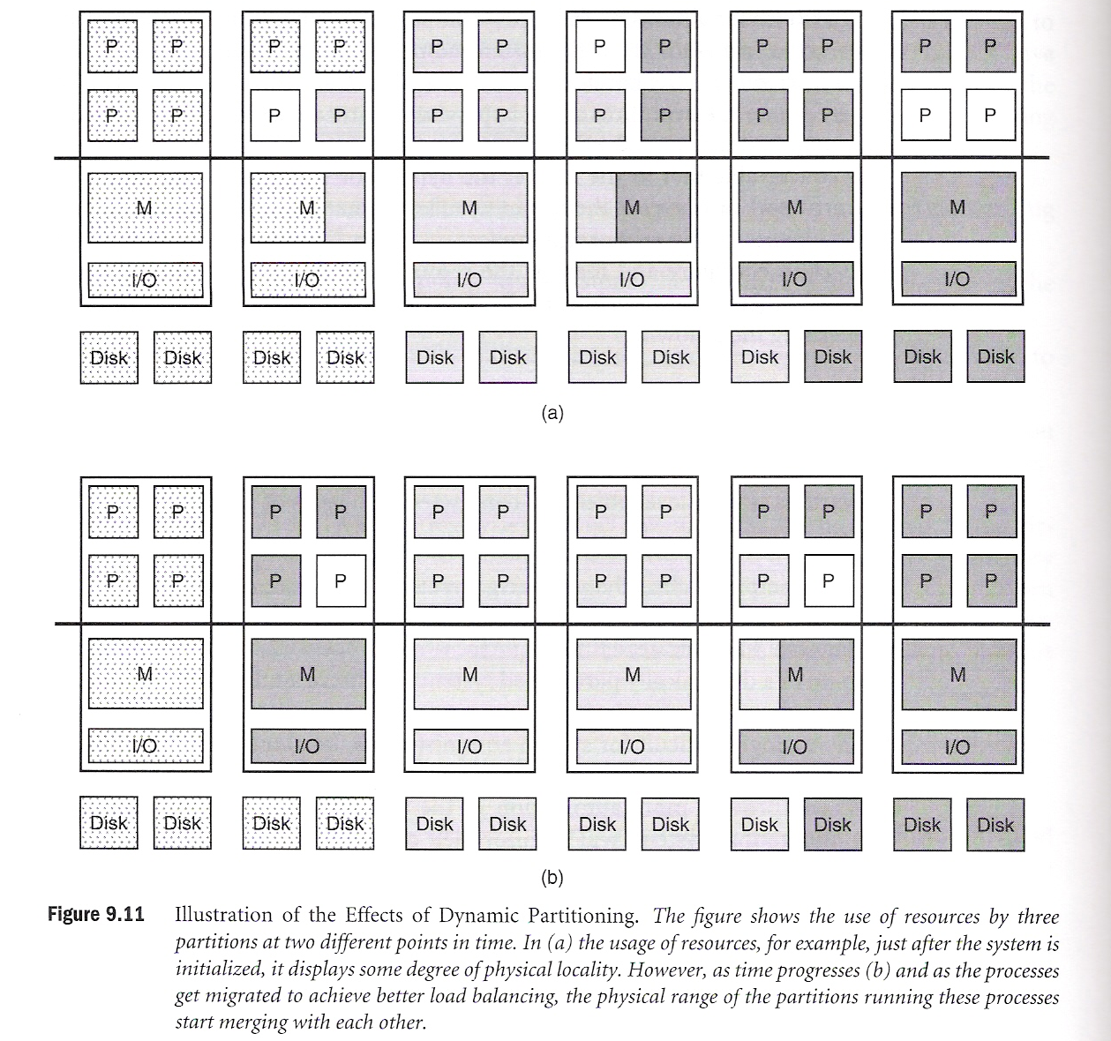
System VM-based Partitioning
Dept. of AI & ML

Slide 76
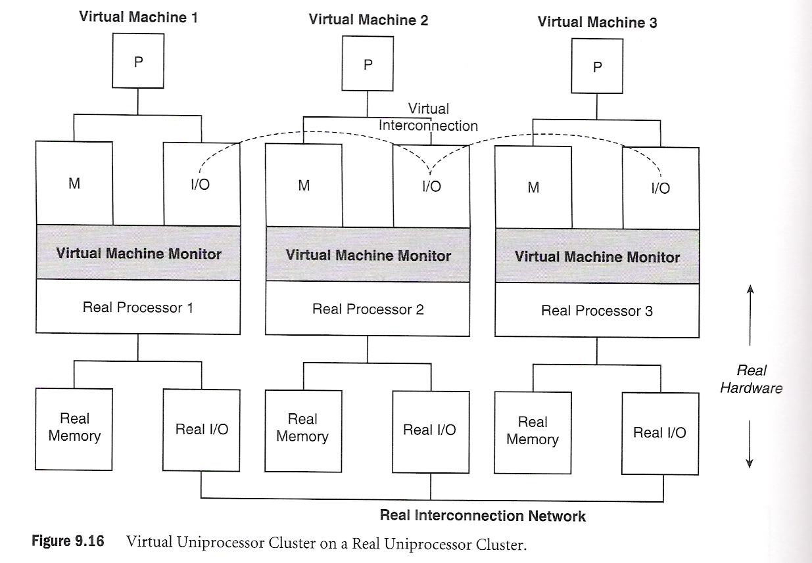
A Virtual Cluster on a Real Cluster
Dept. of AI & ML

Slide 77
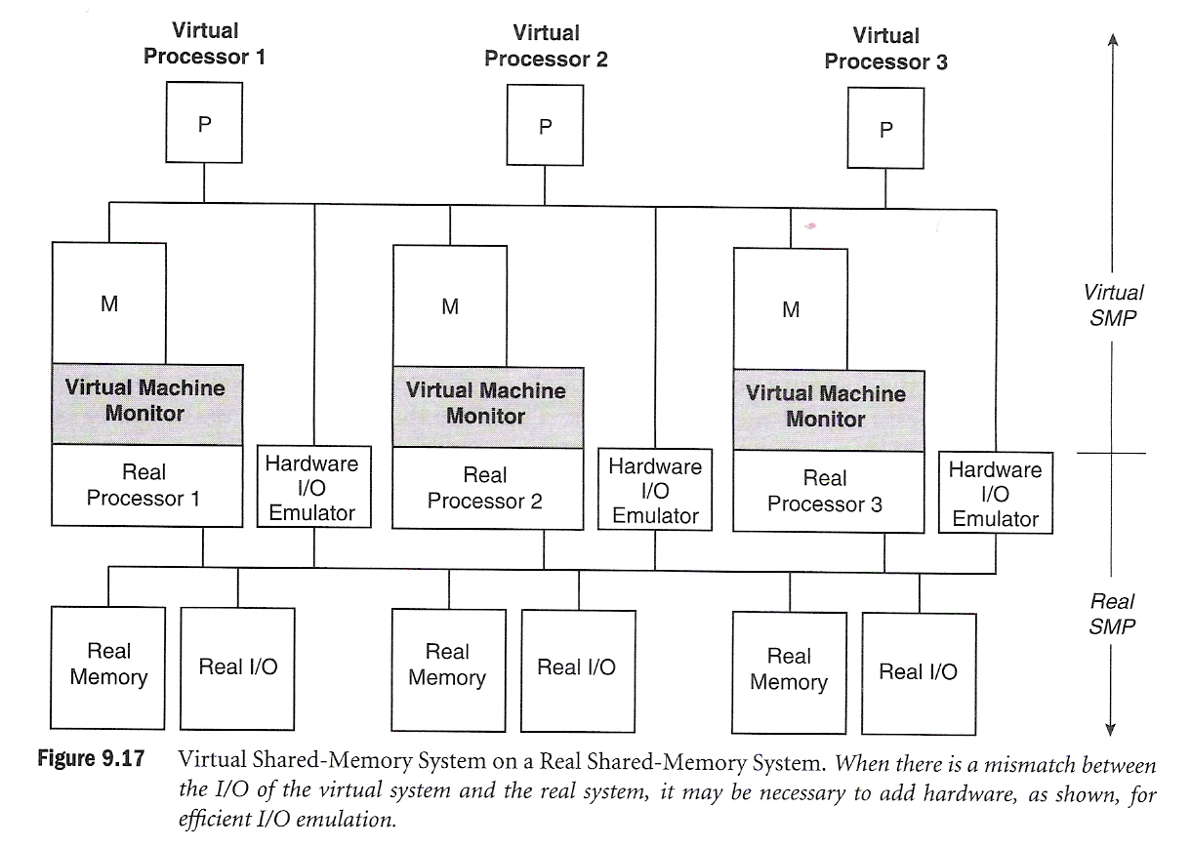
Virtualization with Different Host and Guest ISAs
Dept. of AI & ML

Slide 78
Parallax for VM Storage Management
Dept. of AI & ML

Slide 79
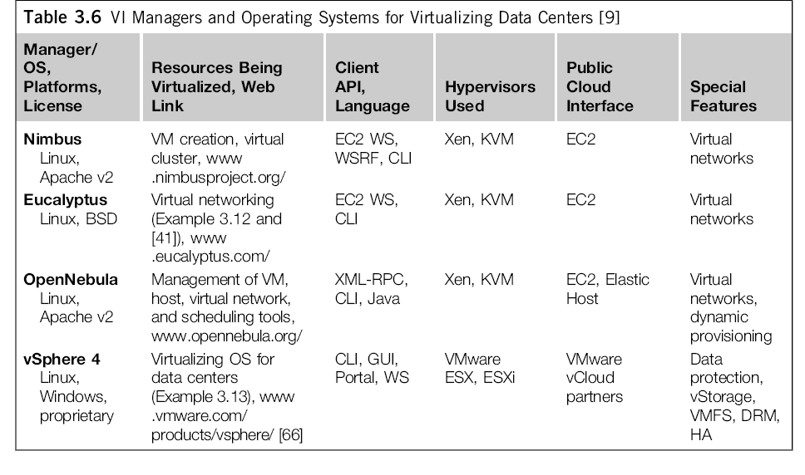
Cloud OS for Building Private Clouds
Dept. of AI & ML

Slide 80
Eucalyptus : An Open-Source OS for Setting Up and Managing Private Clouds
Dept. of AI & ML

Slide 81
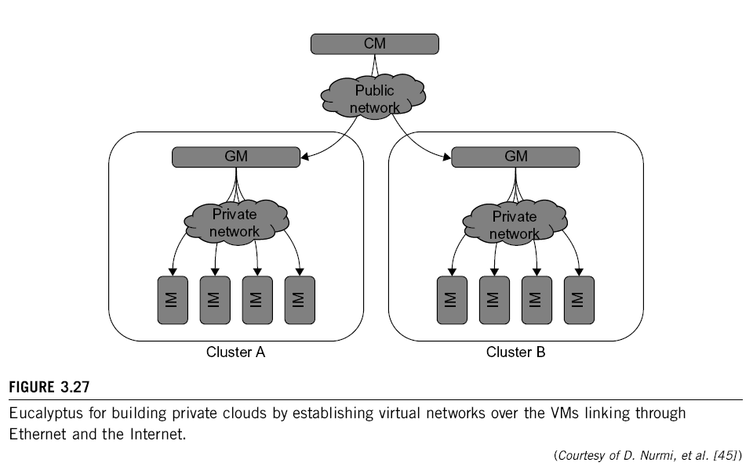
Dept. of AI & ML

Slide 82
Dept. of AI & ML

Slide 83


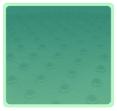



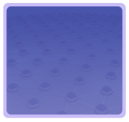

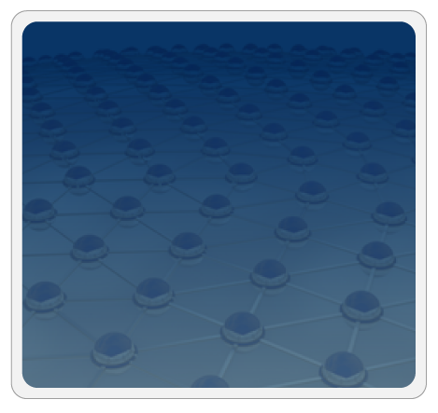



Trusted Zones for VM Insulation
Insulate infrastructure from Malware, Trojans and cybercriminals
Anti-malware
Federate identities with public clouds
Identity federation
Cybercrime intelligence
Strong authentication
APP
APP
Tenant #2
OS
OS
Virtual Infrastructure
Insulate information
from other tenants
Control and isolate VM in the virtual infrastructure
Virtual network security
Data loss prevention
APP
APP
Tenant #1
Dept. of AI & ML
OS
OS
Virtual Infrastructure
Insulate information from cloud providers’ employees
Encryption & key mgmt
Access Mgmt
Segregate and control user access
Cloud Provider
Tokenization
Security Info. & Event Mgmt
Physical Infrastructure
GRC
Enable end to end view of security events and compliance across infrastructures
(Courtesy of L. Nick, EMC 2008)

Slide 84
Projected Growth of Virtualization Market from 2006 to 2011 by IDC
Dept. of AI & ML

Slide 85

Dept. of AI & ML

